Slide 1
Presentation Title Goes Here
Subtitle/Speaker Info
Additional Info/Date

Slide 2
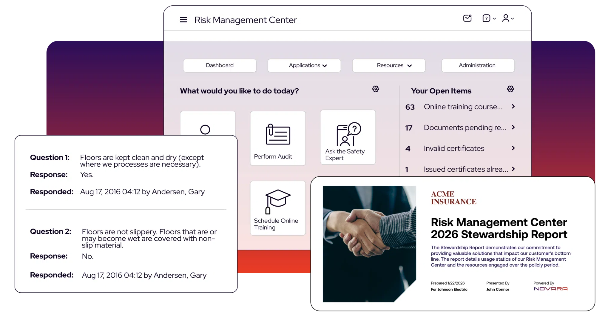

Introducing the Risk Management Center
Faster and Easier Workflows
Managers All Aspects of EHS
Robust Online Training Library

Slide 3

About Our Partner: Novara
Novara delivers solutions that help brokers and producers differentiate themselves in the market.
With the Novara Risk Management Center, you can offer your clients a comprehensive risk prevention and workplace safety platform.
Reduce workplace incidents and accidents
Control total cost of risk
Maintain regulatory compliance
Automate manual processes to save time and money

Slide 4
What is the RMC?
One stop-shop for risk management, incident management, regulatory, and claims reports.
Enables faster and easier workflows
Manage all aspects of EHS and employee development programs
Easily complete all critical risk mitigation, safety, and compliance tasks
Provides robust online training library with over 300 courses

Slide 5

Benefits to Your Business
Growth and Revenue
    Attract prospects
    Increase retention rate of clients
    with value-added services
    Increase revenue
    Consultative selling approach
    Reinforce role as trusted partner

Slide 6

Benefits to Your Business
Add Value for Your Client
    Provide your clients a complete risk prevention and workplace safety solution
    Reinforce your brokerage’s role as their trusted partner
    Deepen existing client relationships
    Reduce/control Ex-Mod

Slide 7
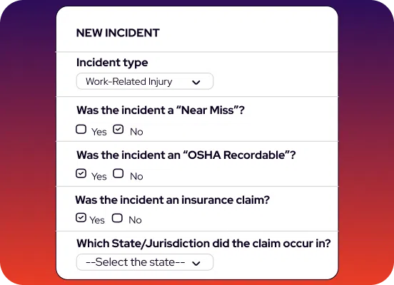
Delivering Value to Your Clients
Reduce Paper-Driven Processes
Reporting
Consistent Communication
Automate Manual Processes

Slide 8
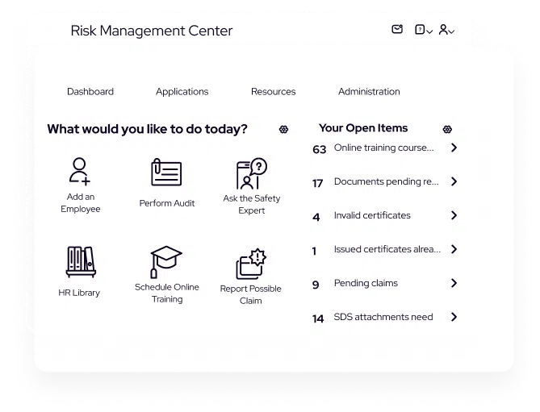
Delivering Value to Your Clients
Insurance Premiums
Fines
Injuries & Absenteeism
Automate Manual Processes
Reduce Total Cost of Risk

Slide 9
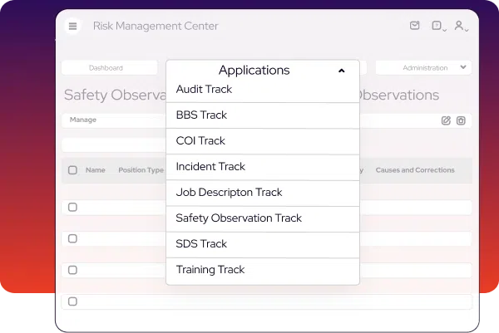
Delivering Value to Your Clients
All-in-One System
Integrated LMS
Cloud-based, Mobile-enabled
Automate Manual Processes
Reduce Total Cost of Risk
All-in-one Comprehensive Platform

Slide 10

Client Testimonials
“Working with the Risk Management Center has been very beneficial to Brady. We are in multiple states, and this provides us training access and forms access for all of our operations managers to utilize in the multiple states we’re in. Because we’re in so many states, the Risk Management Center has helped us tremendously in saving time and money.”
Linda Rux
Corporate Director of Human Resources
Brady Industries

Slide 11

Client Testimonials
“The Risk Management Center has had a tremendous impact on our ability to continue to grow at the organic rates we have been growing at ... our retention levels are well above 98.5% on our large clientele.”
Keith Schuler
President / CEO
InterWest Insurance Services

Slide 12

Client Testimonials
“One of the biggest values for me and this agency has been the utilization of the Risk Management Center in developing new clients.”
Wade Leavitt
Vice-President and Co-Owner
Leavitt Insurance Agency

Slide 13
Benefits of a Safe and Compliant Workplace for Your Clients
Reduced Absenteeism
Minimize Lost Productivity
Avoid Bad Publicity
Fewer Injuries
Fewer Worker’s Comp Claims
Higher Employee Satisfaction
Cost Control
Prevent Lawsuits, Fines and Penalties
Lower Ex-Mod Score
Lower Turnover

Slide 14

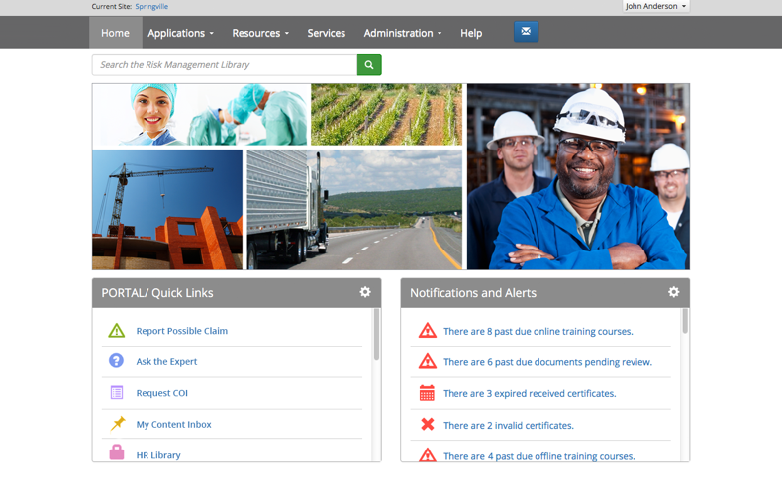
Risk Management Center
Notes:
Now let’s take a look at the features and tools within the Risk Management Center.

Slide 15








The Risk Management Center Includes:
Incident Track®
Reduce your clients’ claims by tracking incidents.
Training Track®
Users track their training—automatically!
SDS Track®
Assist clients with organizing and managing their Safety Data Sheets.
BBS Track®
Help clients build Behavior-Based Safety programs easily!
Job Description Track®
Clients can create job descriptions and return-to-work programs easily.
COI Track®
Help manage your clients’ certificates of insurance before a problem occurs.
Safety Observation Track®
Assists clients in maintaining safe practices in a workplace.
Audit Track®
Help clients create and maintain audits, surveys, and questionnaires.
Notes:
The Risk Management Center Includes eight (8) different tracks to cover all your risk management and compliance needs. As producers you can use carefully crafted approaches to promote awareness and value of the RMC and at the same time create exit barriers to retain your accounts.
Incident Track
Training Track
SDS Track
BBS Track
Job Description Track
COI Track
Safety Observation Track
Audit Track
Each track slide has suggested leverage questions that will give you leverage with you clients, at the bottom of the slide notes. Let’s review each track.

Slide 16
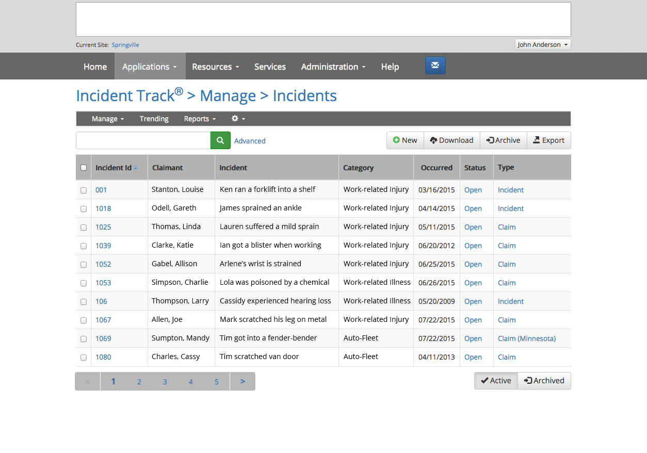
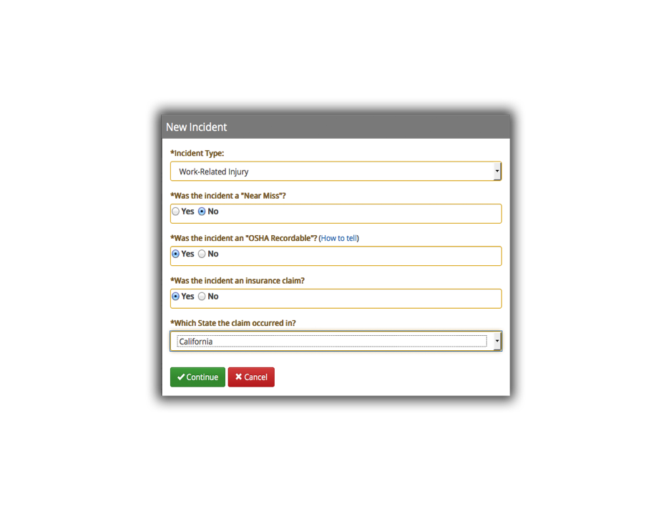
Incident Track®
Automates incident reporting, OSHA logs, and trending
Focus efforts to target loss sources
Near-miss reporting
Manage and maintain your
own data
Notes:
Incident Track®
*Click reveals New Incident window
Automates incident reporting, OSHA logs, and trending
Focus efforts to target loss sources
Near-miss reporting
Manage and maintain your own data
Simple, step-by-step wizard
Investigate and identify root causes, at-risk behaviors, and at-risk conditions
OSHA 300 Log
First Report of Injury: State-specific
Sophisticated Trending and Graphs
Print and distribute trending reports to multiple sites, enabling a targeted, proactive training response.
-----
Some Helpful Questions for Clients:
What’s the process to log and accident or incident?
How do you track and trend incidents for frequency or possible severity?
What is your OSHA 300 process and who is in charge of submittals?
What kind of assistance do you currently get in highlighting problem areas and providing solutions?
Who helps you prepare training programs when you notice an increase in certain types of incidents?
Did you know? Accident tracking software can cost up to $3,000-$15,000 (Vendors Examples)

Slide 17
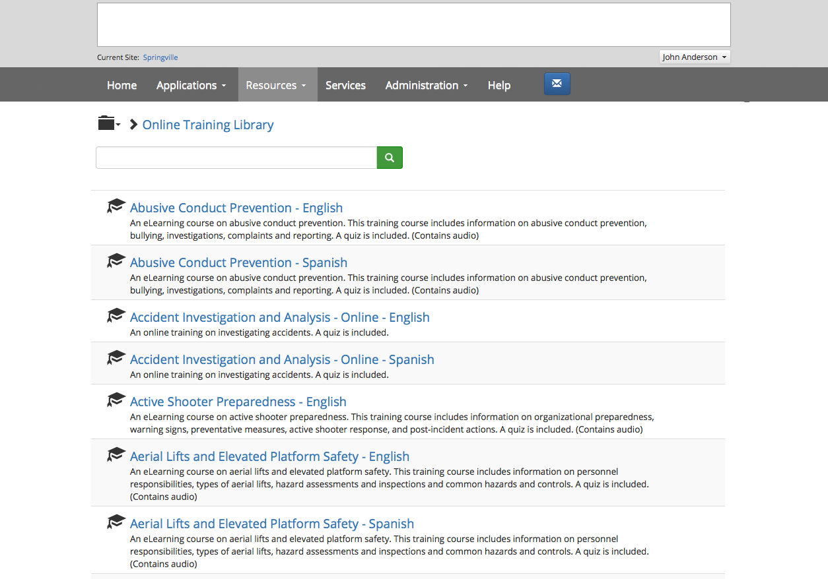

Training Track®
Track your training automatically & stay OSHA-compliant.
Schedule and record training sessions for your employees effortlessly.
Employees and Managers receive reminders of trainings coming due.
Keep records and run reports easily by using Training Track as your solution.
View brochure
Notes:
Training Track
*Click reveals Online Training Information window
*2nd click reveals Portable Ladder Safetywindow
Track your training automatically & stay OSHA-compliant.
Schedule and record training sessions for your employees effortlessly.
Employees and Managers receive reminders of trainings coming due.
Keep records and run reports easily by using Training Track as your solution.
Training Track delivers the scope and flexibility needed for a complete and automated online training program.
Pause scheduled trainings
Download certificates of completion from Training History
Recording Offline trainings
Include attachments
Track and record the instructor of the course, cost, education credits, and license information
Clear distinction between Online and live training throughout Training Track
Create training categories for classroom trainings
Schedule training – online, live, and by Employee
Auto-notifications
Clear and useful reporting
Review training information, preview, and schedule an online training from the library
Trainings are accessible across all major desktop, laptop, and tablet formats, and all major web browsers
Safety Videos
The extensive library spans dozens of industries and topics including industry-specific safety, compliance, human resources, healthcare, and school staff training videos, plus much more.
Over 300 courses
Available in both English & Spanish
Safety Videos can be accessed from the Library
100% OSHA/DOT/EPA-compliant
Employee Portal
Your employees have their own portal, where they can access assigned training, library materials, News and Announcements, and more.
Online e-Learning: efficient, convenient, and cost-effective
Instant ROI
Cost savings versus classroom-based training
Access anywhere with an internet connection
Reduces incidents, accidents & claims
Ensures compliance
Targeted training to address loss sources
Client Success Story
Company: Precision Castparts Corp.
Issue: This company needed to reduce training costs and be able to train employees efficiently.
Solution: Succeed converted over 20 employee New Hire and General Safety training courses from PowerPoints to automated online courses. This streamlined productivity, and training assignments were automatically monitored and tracked in Training Track™.
Results: One division has realized annual hard-dollar savings of $23,000 by converting instructor-led classroom courses into automated online programs. Divisional Training Coordinator says, "we are saving hundreds of hours in productivity due to these online training programs, and we are just getting started!" The company has already made plans to continue to transfer all applicable training to an online training format.
Training Cost Savings Calculator: ROI & Discovery

Slide 18
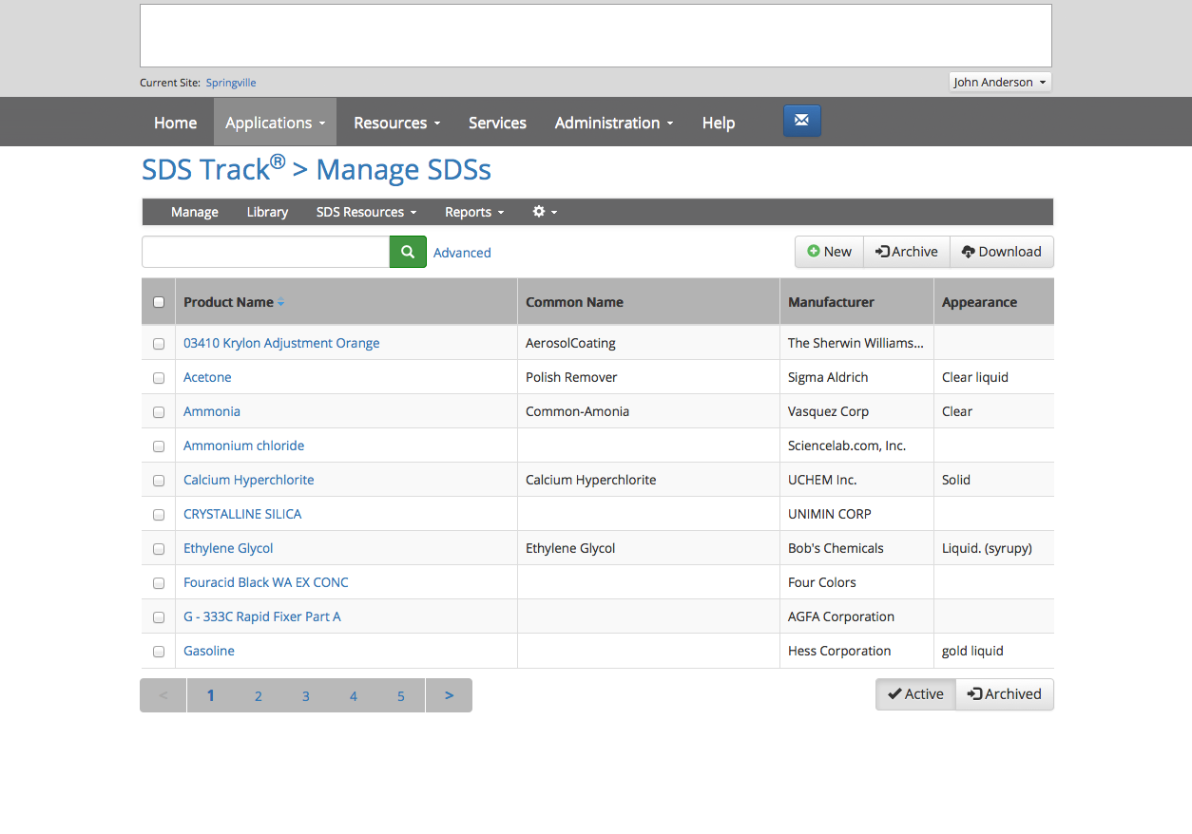
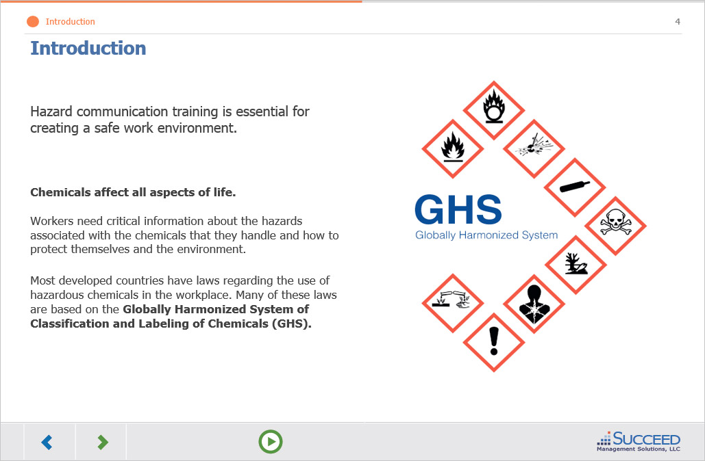
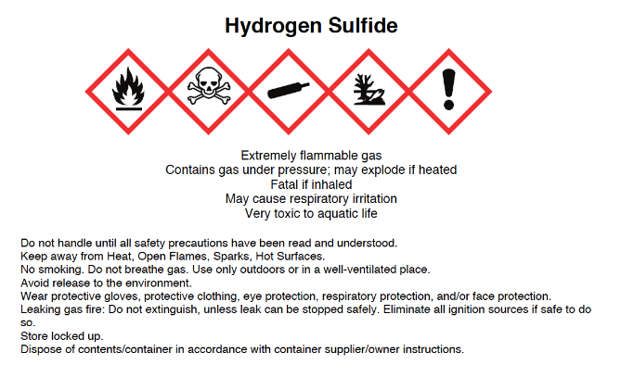
SDS Track®
Organize, manage, and provide access to Safety Data Sheets (SDSs).
OSHA’s Hazard Communication (GHS) and “Right-To-Know” standards compliance through accessibility
GHS-compliant training courses for both managers and employees.
Print GHS, HMIS and NFPA labels
View Brochure
Notes:
SDS Track
*Click reveals GHS Screen Shot window
**2nd Click reveals label window
Organize, manage, and provide access to your organization’s Safety Data Sheets.
Easily load existing SDSs
Provide employee access to SDSs from any computer with internet access
Print Labels
Increase workplace safety
Print GHS, HMIS and NFPA labels.
A complete system to organize, manage and provide access to your Safety Data Sheets (SDSs)
OSHA’s Hazard Communication (GHS) and “Right-To-Know” standards require a Safety Data Sheet (SDS) for each chemical.
We have GHS-compliant materials including two comprehensive GHS training courses for both managers and employees.
GHS Compliance & Label Printing
Enable compliance with regulators
Fully GHS-compliant software solution
Need help entering and managing your SDSs? Ask us!
-----
Some Helpful Questions for Clients:
Are you up to date on the Global Harmonization change for 2016?
How do you manage Safety Data Sheets, manuals, electronic, online?
What is the process to update the chemical inventory changes to your SDS?
Do you outsource your SDS solution?
SDS cost $5,000 to $7,000

Slide 19
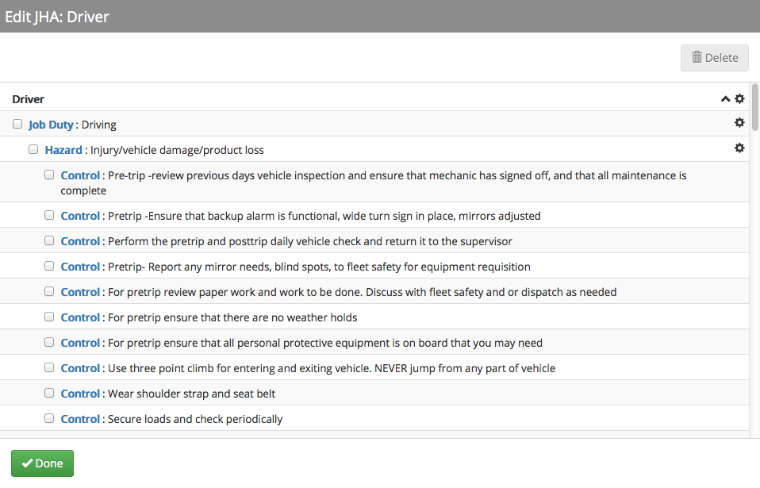
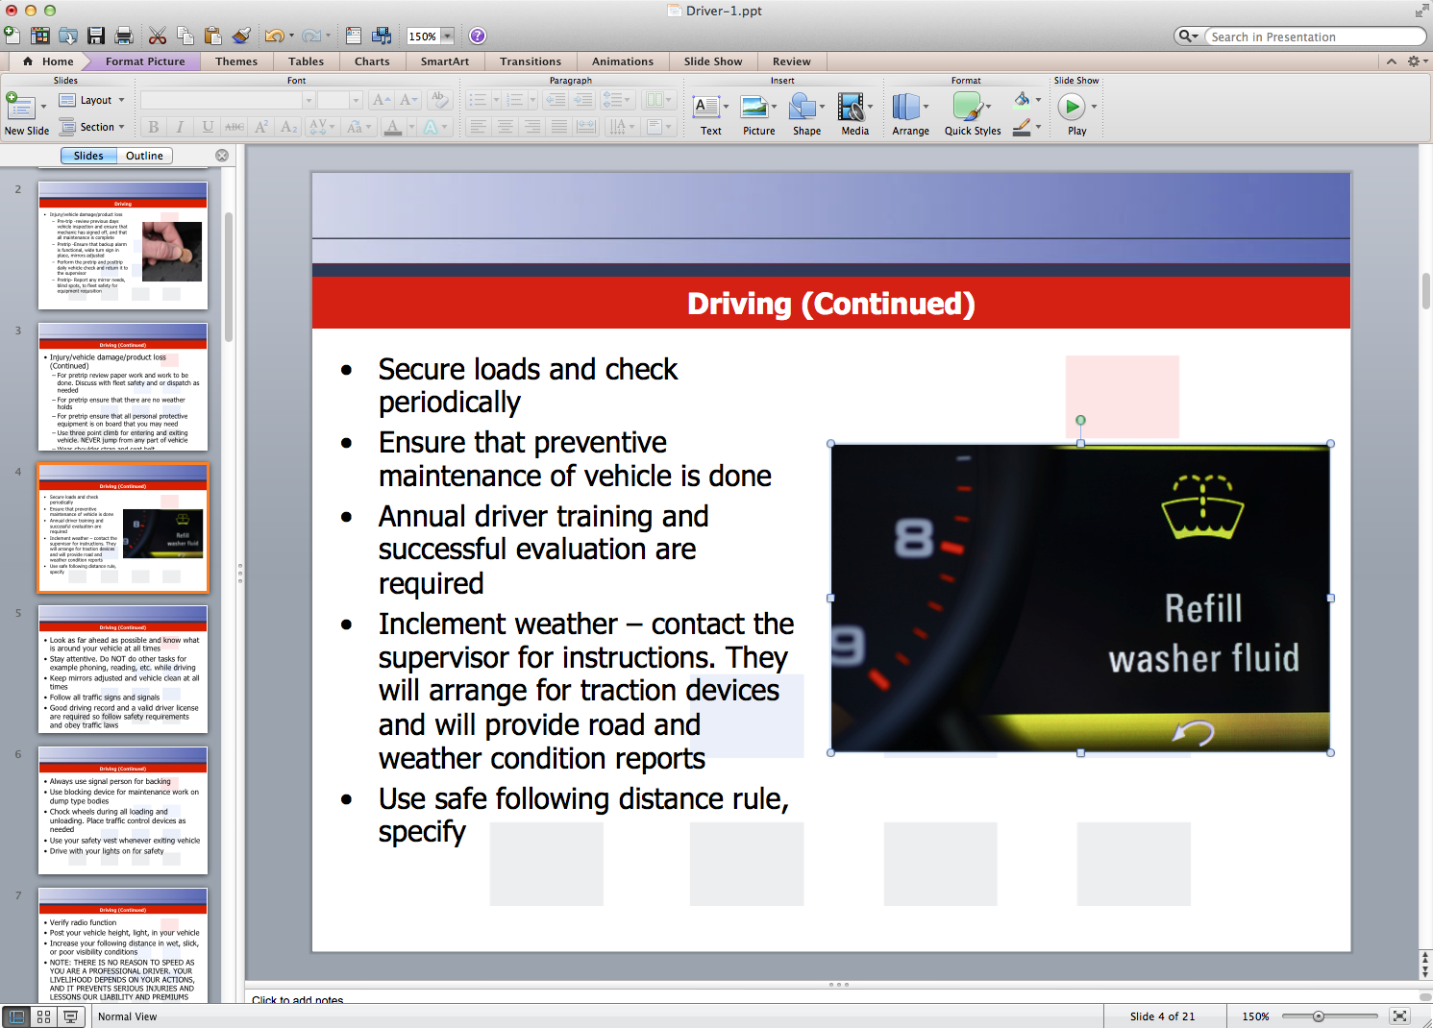
BBS Track®
Build Behavior-Based Safety (BBS) Programs easily.
Drive down losses and build an effective safety culture
Customize your Hazard Analyses
Create PowerPoints that are fully customizable from JHAs
View Brochure
Notes:
BBS Track
*Click reveals PPT window
Build Behavior-Based Safety (BBS) Programs easily.
Export a PowerPoint for easy training
Build your Job Hazard Analyses quickly
Utilize our pre-loaded Hazard Analysis Library
Customize your Hazard Analyses
Drive down losses and build an effective safety culture
Add steps, issues and job requirements as necessary
Printing functionality
Create PowerPoints that are fully customizable from JHAs
Request conversion into online training programs

Slide 20
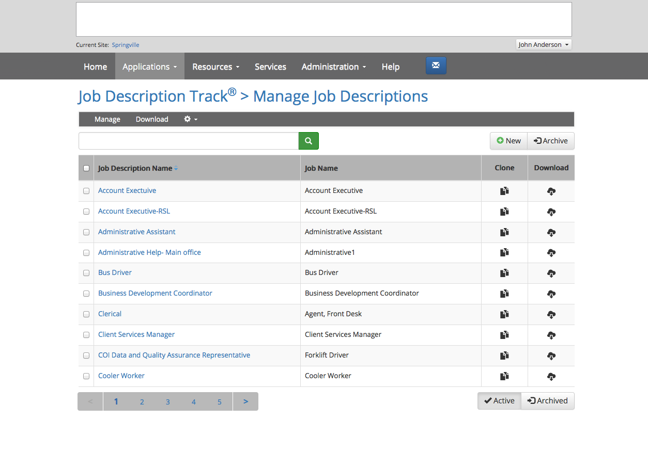
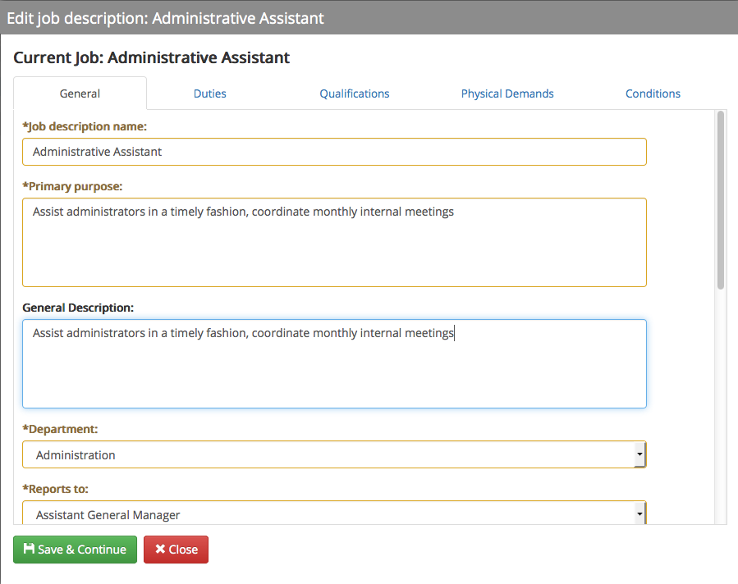
Job Description Track®
Create Job Description and Return-to-Work programs easily
Adopt HR Best Practices
Align with ISO Standards
Customize to your organization
View Brochure
Notes:
Job Description Track
*Click reveals Edit Job Description window
Create Job Description and Return-to-Work programs easily with our Job Description creation software.
Adopt HR Best Practices
Align with ISO Standards
Create Job Descriptions in minutes
Implement Return To Work Job Descriptions
Customize to your organization
Use our Example Library to supplement Job Descriptions
Quickly build job descriptions to clearly communicate roles, responsibilities, and performance expectations.
Develop and maintain a library of updated job descriptions, including modified duty job descriptions, to demonstrate HR compliance

Slide 21
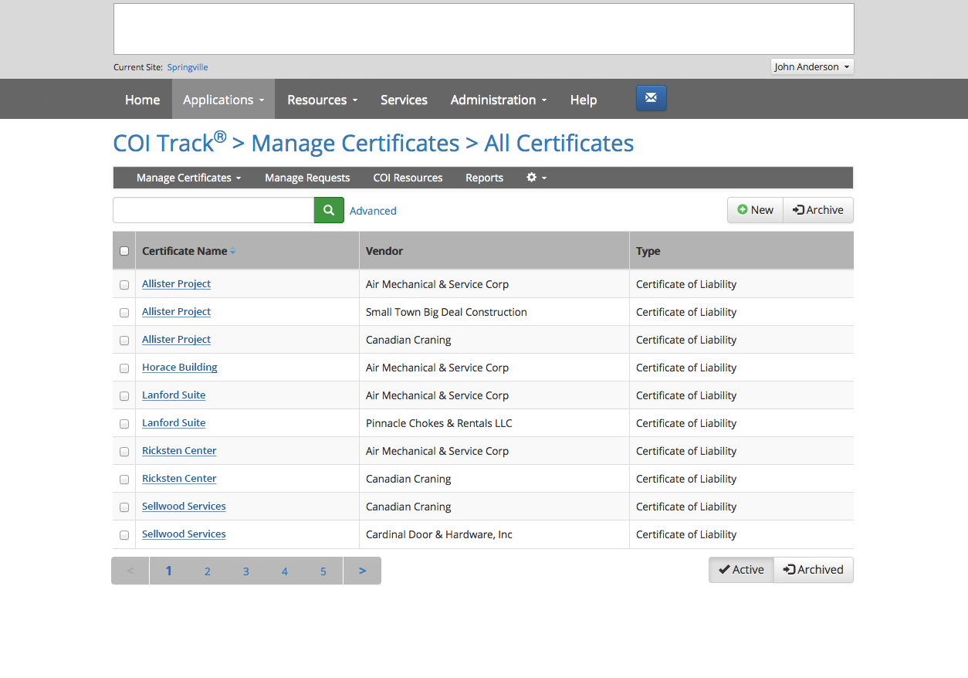
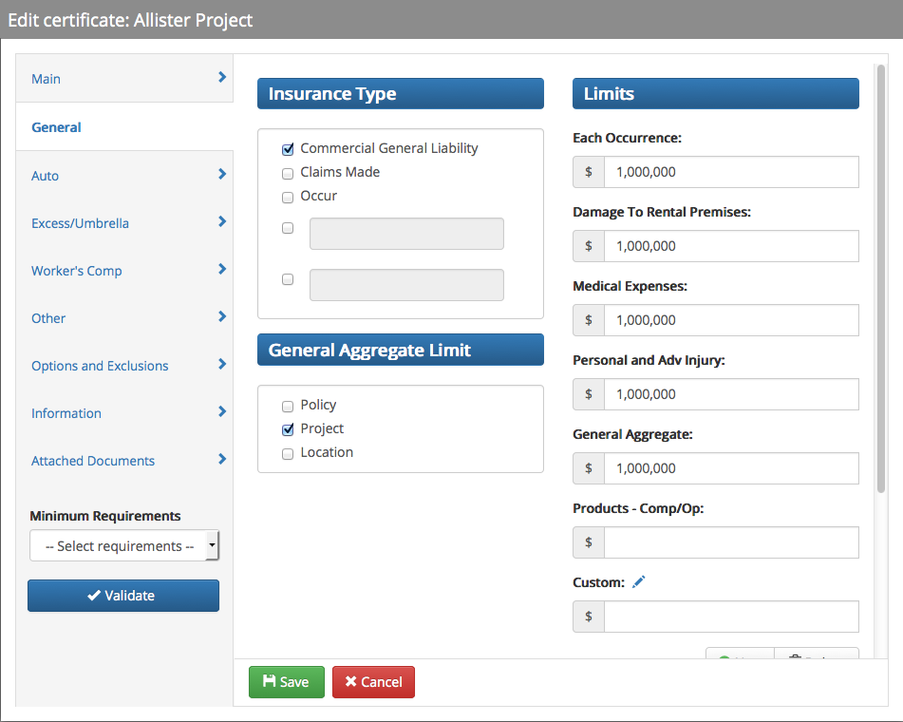
COI Track
Manage Certificates of Insurance before a problem occurs.
Prevents significant liabilities, and addresses insurance needs
Maintain up-to-date vendor records
Data will be tracked and reviewed against the contractual requirements
View Brochure
Notes:
COI Track
*Click reveals Edit Certificate window
Manage your Certificates of Insurance before a problem occurs.
Automates tracking and manages Certificates of Insurance
Makes loading certificates easy
Prevents significant liabilities to your organization, and addresses insurance needs
Streamlines the certificate of insurance management to minimize risk by maintaining up-to-date vendor records.
Manage certificates from a single menu
Add certificates and view/initiate workflows
Reports
Easy setup
All needed data will be tracked and reviewed against the contractual requirements
Layout of setup menu
Easy-to-use guide to add new certificates of insurance

Slide 22
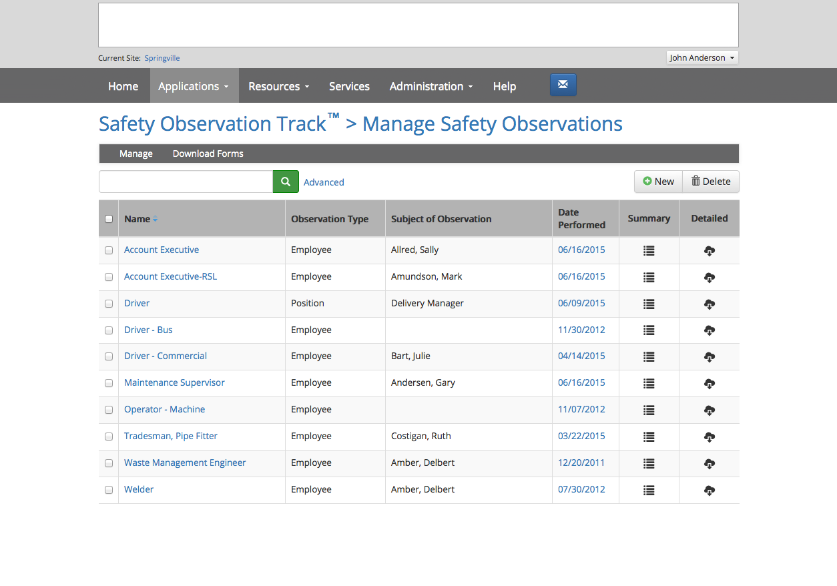
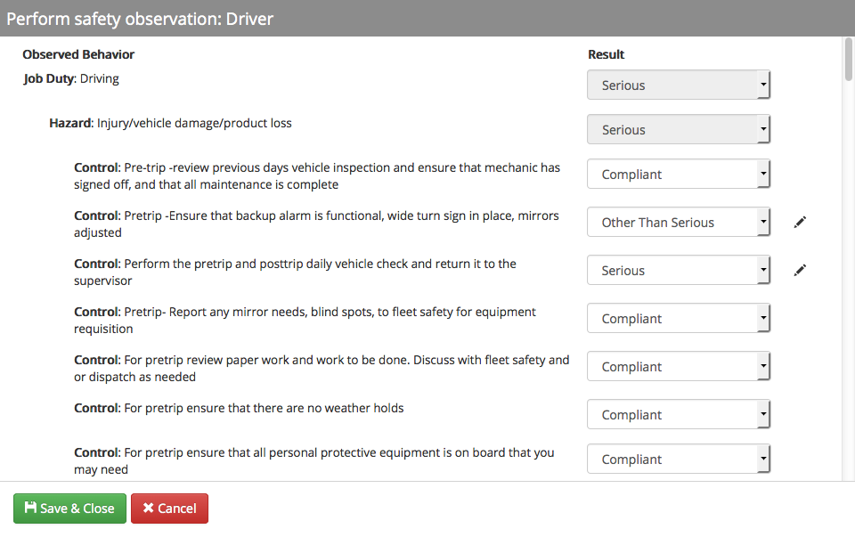
Safety Observation Track®
Perform and track safety observations based on the JHA’s
Easily search and generate a summary or detailed report
Print a blank safety observation form, for the field
Assure that your employees are doing their jobs safely
View Brochure
Notes:
Safety Observation Track
*Click reveals Perform Safety Observation zoom
Perform and track safety observations based on the JHA’s created in BBS Track
Identify hazards
Demonstrate job compliance
Identify root causes
Assign corrective actions for any non-compliant areas
Easily search through observations and generate both a summary and detailed report
Print a blank safety observation form, for the field
Assure that your employees are doing their jobs safely

Slide 23
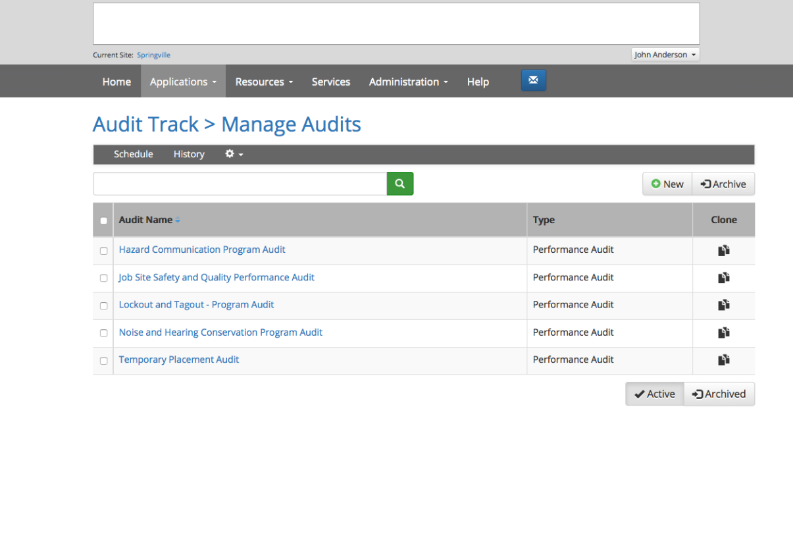
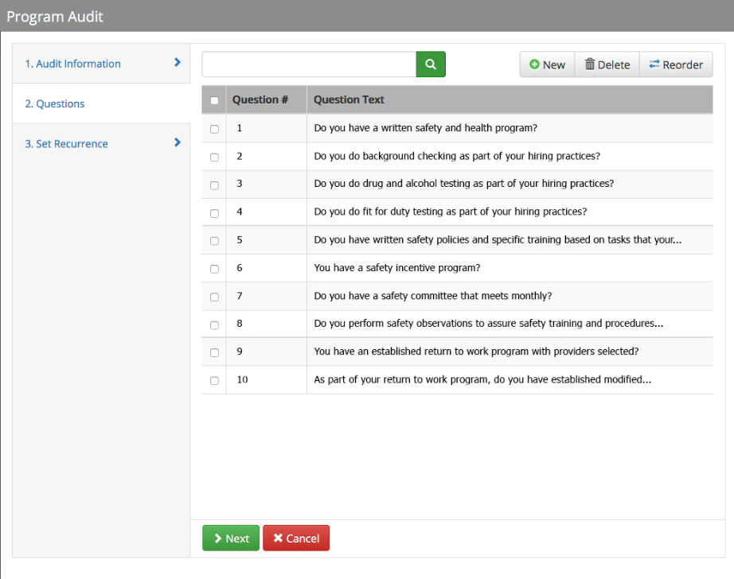
Audit Track®
Create custom audits for organizations and departments
Deploy in the field on any major mobile device
Target and resolve revealed issues before they become incidents
Keeps all Audits, Inspections, and Assessments up-to-date
View Brochure
Notes:
Audit Track
*Click reveals Program Audit window
Create and maintain audits, surveys, and questionnaires. This application allows you to streamline the audit process.
Create custom audits for organizations and departments
Deploy in the field on any major mobile device
Detailed reports based on your criteria
Allows you to target and resolve revealed issues before they become incidents
Keeps all Safety Audits, Inspections, Self-Assessments, and other workplace checklists up-to-date

Slide 24





The Risk Management Center Resources
Risk Management Library
Policies, procedures, training shorts, posters, training materials, quizzes, links, and more
Risk Management Manual
Build your risk management manual from My Content
My Content &
My Content Inbox
Create and distribute your own documents from internal resources or edited Library resources and documents
News, Calendar of Events, Announcements
Contains important news and timely resources
HR & Benefits Library
A comprehensive HR Library to help your organization stay compliant with federal and state labor laws
Notes:
The Risk Management Center has additional resources available.
The Risk Management Library contains policies, procedures, training shorts, posters, training materials, quizzes, links, and more.
Personalize the Risk Management Center by creating and distributing your own documents from internal resources and documents and build your own risk management manual.
Stay up to date with important news and timely resources.
A comprehensive HR Library to help your organization stay compliant with federal and state labor laws.

Slide 25
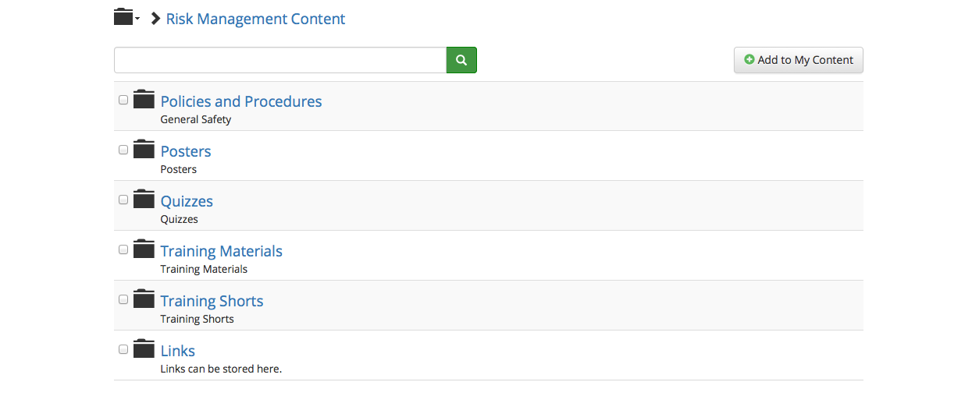
Risk Management Library®
Enhance your safety program with a multitude of bilingual safety and risk management resources.
Notes:
Establish guidelines and procedures
Improve training programs
Inform and engage employees
Create a safety culture
Demonstrate compliance
Form an Injury and Illness Prevention Program
All documents are printable, downloadable, and customizable.
The format is either Microsoft Word or PowerPoint.
Use templates to enhance your health and safety program.

Slide 26
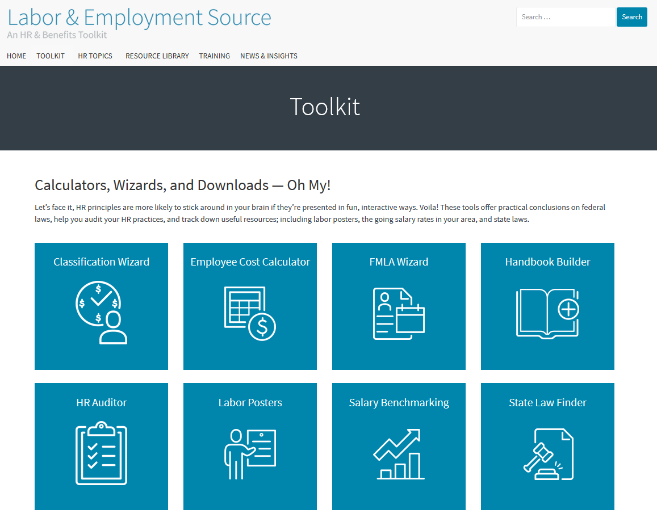
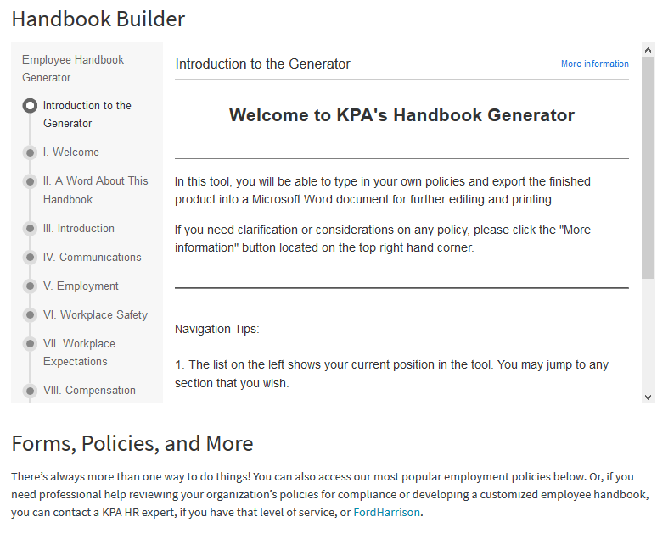
Labor and Employment Source
Connects you with essential human resources documents, tools, and insights.
Notes:
One-stop Source
On-demand expertise from certified HR experts
Interactive HR tools
Classification Wizard
Salary Benchmarking
HR Auditor
Employee Cost Calculator
FMLA Wizard
Handbook Builder
State Law Finder
Labor Posters
Regulatory advice you can use —including state and federal information
100s of practical, compliant resource downloads
Easy ways to quickly search topics of interest
Training resources
Bi-monthly videos & webinars on trending HR topics
Customized Resources
Need a specific compliance document? There are two ways to go.
1. Through the Give Feedback feature, you can submit content requests that can then be voted on and developed. It’s proactive, not reactive!
2. Custom documents can be developed just for you with your access to Ask the HR Expert.
Spotlight on Ask the HR Expert
Have a state- or industry-specific compliance question? Want to talk with an expert to gain the reassurance that you’re on the right track?
The Labor & Employment Source is more than just a website, it’s also a lifeline to HR experts.
Team of certified HR and benefits consultants available by phone or email
Response within 4 business hours
No question limits
Legal consultation available

Slide 27
Excellence in Service
Additional Services:
  Daily webinars to help train your client’s staff to use the Risk Management Center
  Full support
  Branded weekly training shorts and helpful safety tips
  Access to experts for specific questions and concerns with Ask an Expert
  Customize online training needs with the Custom Online Training Service
  Database Management Services
Daily Platform Training Webinars
Trailing Shorts Schedule

Slide 28
We Help You Sell and Create Exit Barriers
Sample leverage questions for your clients:
What kind of assistance do you currently get to highlight problem areas and provide solutions?
How do you track incidents for frequency or possible severity?
Who helps you prepare training programs when you notice an increase in certain types of incidents?
What does your current Payroll Service Provider do to assist?
Do they have a tool like the RMC they provide to you?

Slide 29



Diagnose the Prospect
The Novice
  No EHS or HR team
  Minimal formal structure or expertise
  Need help with ongoing management
The Overwhelmed
  Mid-level EHS & HR team
  Specifically designed program using software and training
  Need management and inspection help
The Expert
  High-level dedicated internal EHS & HR teams
  Premium professionally designed software solution
  Require a customizable tool
Notes:
Level 1 – The Novice
Loss control and HR duties
Non-existent
Lack a dedicated person
Part time gig
Incidents, issues, and other documents and training
Not tracked or recorded
Lack safety culture
High MOD rate and insurance premiums
High indirect costs associated with incidents
Untrained employees, leading to additional incidents
No safety committee meetings
No formalized HR onboarding with training
Level 2 – The Overwhelmed
Some dedicated loss control or HR personnel (varies by locations)
Safety efforts present, but still issues
Incidents and issues tracked using inadequate methods (spreadsheet)
Limited software and training investment
Loss control and audit process, but little corporate responsibility
Safety committee meetings may be present but not effective
Level 3 – The Expert
Dedicated loss control or HR management and staff
Multiple locations with onsite Loss Control or HR personnel
Substantial investment in software and training platforms
Well-defined, measured and tracked processes
Formalized loss control audit inspection process
Require multiple platforms or vendors to manage loss control or HR processes
Software solutions may not “talk” to each other

Slide 30
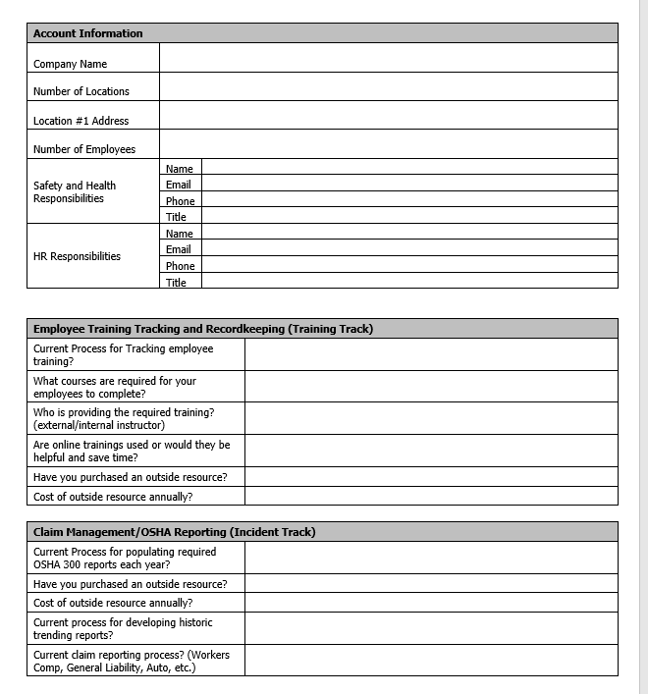
Discovery Form
6 out of 10 businesses will respond to the form
Send it well in advance of the
renewal date
Create the ADVANTAGE

Slide 31

Account Management Services
An assigned account specialist will help you tailor the RMC to your organization to deliver an integrated solution and improve productivity.
RMC Onboarding Configuration
Software Training
RMC Ongoing Assistance & Support
Follow Up and Quarterly Specialist Calls
Notes:
Account Management is also available through KPA and includes the following:
RMC Onboarding Configuration
Your Account Specialist will help you tailor an implementation strategy for two applications of the RMC to fit your organization’s needs. An implementation strategy meeting will be facilitated to develop a roll-out plan for user and employee adoption.
Software Training
Your Account Specialist will work with you to provide personalized training for applicable personnel to begin using the two identified priority applications for implementation. Up to four hours personalized training is included in this service.
RMC Ongoing Assistance & Support
Your Account Specialist will be available online and by phone to help you leverage the RMC to effectively implement time saving, efficient solutions to your risk management processes.
Follow Up and Quarterly Specialist Calls
We follow up with one call after two weeks, and then quarterly calls from your Account Specialist for additional training.

Slide 32
Thank you.

